Slide 1
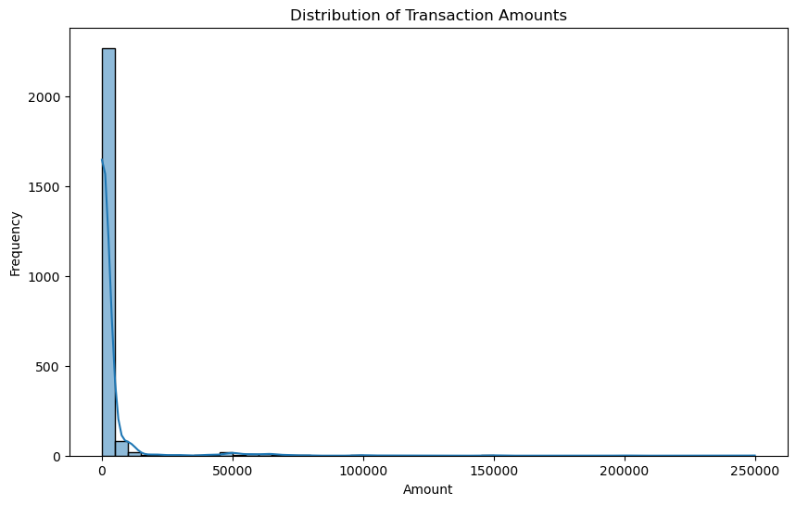
Distribution of Transaction Amounts
Histogram with KDE Plot of Transaction Amounts

Slide 2
Analysis of Histogram
Histogram and KDE Curve: The smooth line is the Kernel Density Estimate, which shows an estimated probability density function of the data — it’s a smooth version histogram.
What is represents and how to analyse it?
The peak of the distribution is on the left side of the graph.
The tail extends far to the right, toward higher transaction amounts.
Analysis
Most of the transaction amounts are small, but there are a few very large amounts
pulling the mean to the right.
The distribution of transaction amounts showed a right-skewed pattern with most
transactions clustered around lower values.
A small number of transactions are very high — these are outliers.

Slide 3
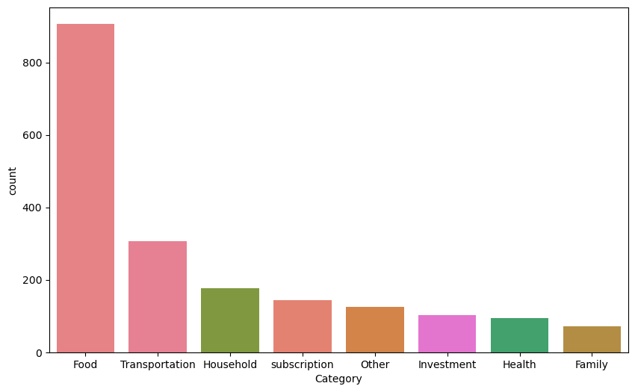
Count of Transaction per Category
Bar Plot of Transaction Counts per Category

Slide 4
Analysis of Category Bar Plot
X-axis (Category): Different types of spending or transaction categories (e.g., Food, Transportation, Household, etc.).
Y-axis (Count): Number of transactions in each category.
What it represents and how to analyze bar plot?
Food has the highest number of transactions — over 850, making it the most frequent category.
Family has the lowest count, under 100.
Analysis
Food related transactions are regular and routine. Food is a basic requirement of human beings, thus spending on it would naturally be the higher proportion of our overall income and transactions.
This provides an opportunity for a business who is engaged in food business to further analyze the data. This will allow the business to understand the taste and preferences of customers and how it can market its products.

Slide 5
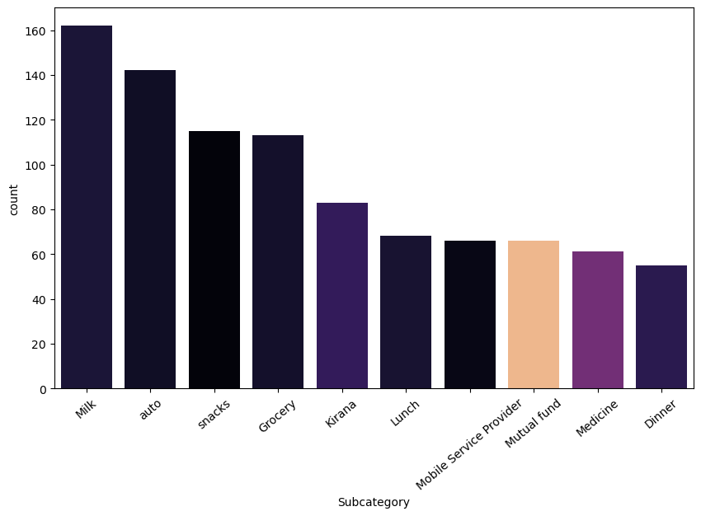
Count of Transactions per Sub-Category

Slide 6
Analysis of Sub-Category
Milk has the highest frequency in the sub-category more than 160. It means that people are buying milk frequently and regularly. This provides an opportunity to the milk producing companies to market and cater to these needs.
The second highest frequency or count is auto, auto means automobiles (petrol) which include cars, motorcycles e.t.c. It represents a large number of petrol buyers after milk.
Auto is followed by Snacks, Grocery, Kirana, lunch e.t.c Combines these three sub- categories and milk, it represents the Food Category. These sub-category are the reasons why Food has the largest frequency of transactions.
The least frequency of transaction is of Dinner. It can be observed that families prefer to cook food at home rather than going out to dinner. This helps in identifying the eating patterns(culture) of the population.

Slide 7
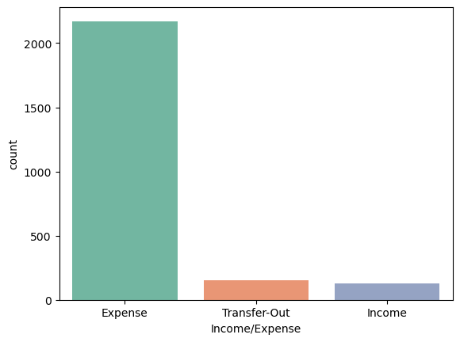
Count of transactions having income/expense

Slide 8
Analysis of income/expense
🟥 Expense (Far Left Bar)
Overwhelming majority of transactions fall under this category (2200+).
Indicates that most financial activity is outflow — spending is dominant.
Reflects active use of money for purchases, bills, or other costs of living.
🟧 Transfer-Out
A relatively small number of transactions (~150–200).
Likely represents moving money between accounts (e.g., from a checking
to savings account, wallet to bank, etc.).
Doesn’t imply spending — it's a reallocation.
🟦 Income (Far Right Bar)
Even fewer transactions recorded as income (~130–150).
Doesn’t necessarily mean low income — just that income entries are less
frequent (e.g., salary received monthly).

Slide 9
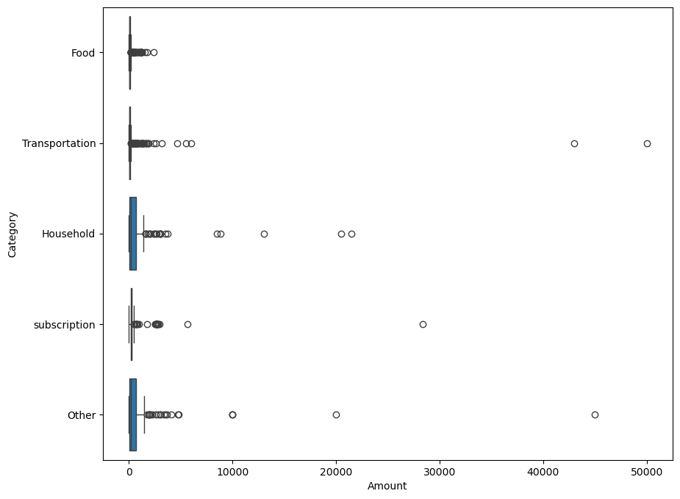
Box Plot of the amount in Each Category

Slide 10
Insights from Categories Box Plot
Insights from the Box Plot:
Household and Other categories have many high outliers, indicating some large, unusual expenses.
Most categories have the majority of their spending clustered near the lower end (left side), suggesting regular but small expenditures.
Transportation and Household have wider boxes, meaning more variability in spending.
Food and Subscription have relatively consistent spending, with fewer large outliers.

Slide 11
Analysis of Box Plots
How to Analyze the box plot
Each box corresponds to a "Subcategory" (only the top 10 by count).
The x-axis ("Amount") shows the distribution of transaction amounts.
Each box provides key statistical insights: The median (central line in the box).
Represents the middle transaction amount for that subcategory.
The Interquartile Range (IQR): The range between the 25th percentile (Q1) and the 75th percentile (Q3), indicating where most values fall.
Whiskers: Extend up to 1.5 times the IQR from Q1 and Q3, covering most data points.
Outliers (dots outside whiskers): Extreme transaction amounts that are significantly different from the rest.

Slide 12
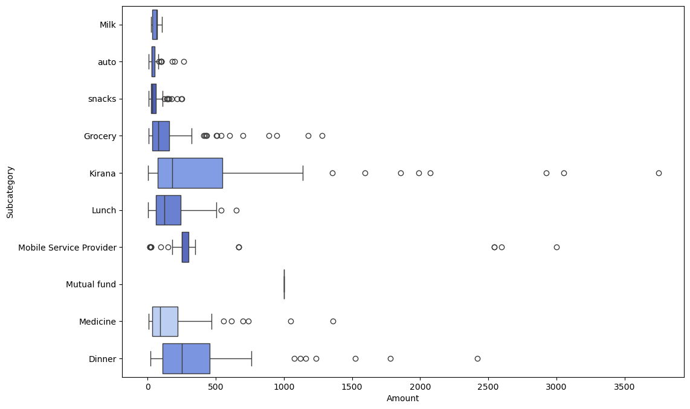
Box Plot of Amount in Sub Categories

Slide 13
Analysis of Box Plot of Sub Categories
Insights from the box plot :
Grocery and Kirana have many big outliers, indicating some large usual expense.
Majority of the spending amount is concentrated from Rs.0 to Rs.1000. However there are a number of outliers in each category that might take mean on the higher side.
Most of the sub-categories are right skewed. However, milk spending is almost symmetrical, representing that milk prices are not highly variable.

Slide 14
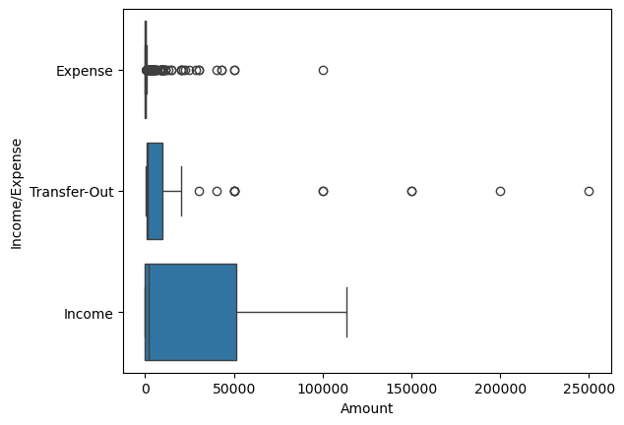
Box Plot of Income/Expense

Slide 15
Analysis of Income/Expense Box Plot
All three categories are right-skewed, especially Expense and Income.
Income has the highest variability in transaction amounts.
Expense has the smallest typical transaction size but a large number of outliers.
Transfer-Out lies in between in terms of typical value and outlier range.

Slide 16
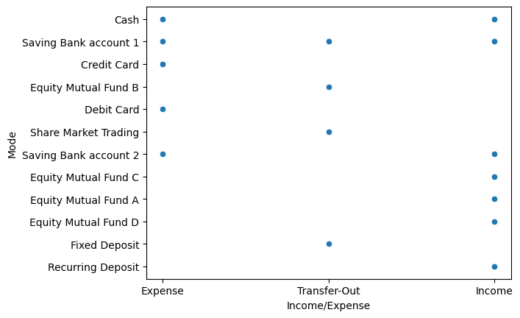
Scatter Plot of Expense/Income

Slide 17
How to analyse Scatter Plot
Scatter plot highlights the variety of financial methods used across transactions.
Income | Expense | Transfer Out
Cash | Cash | Saving Bank Ac 1
Saving Bank Ac 1 | Saving Bank Ac 1 | Equity MF B
Saving Bank Ac 2 | Credit Card | Share Market Trading
Equity MF C | Debit Card | Fixed Deposit
Equity MF A | Saving Bank Account 2
Equity MF A
Recurring Deposit

Slide 18
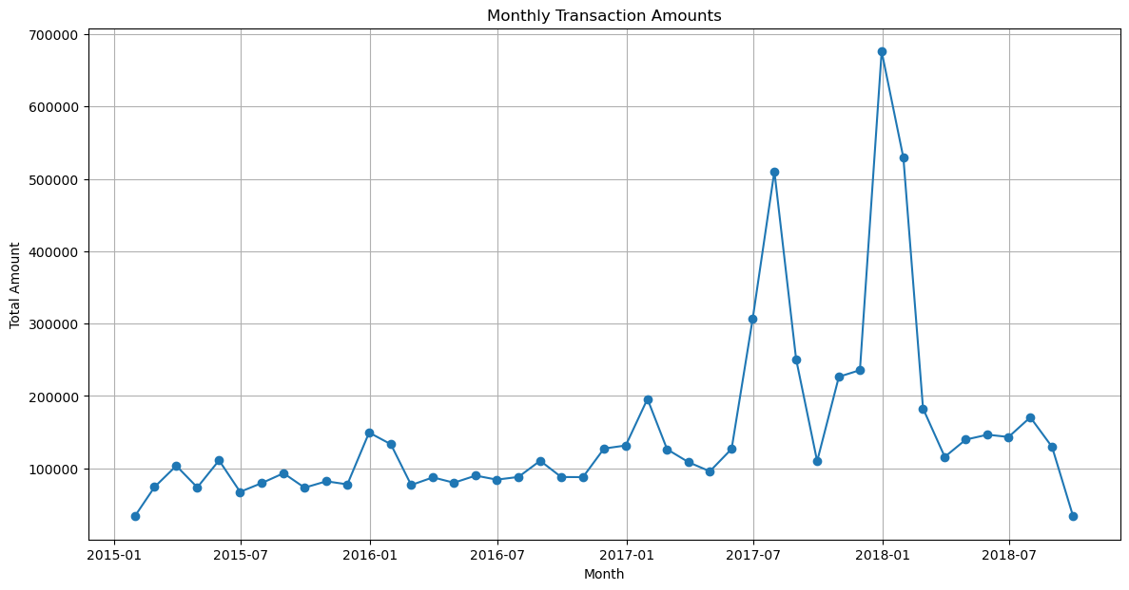
Distribution of Transaction Amount

Slide 19
Insights derived from Line Chart
2015-2017
Monthly transaction amount hovered around 1 lakh.
Spending is routine and Stable.
2017
Beginning witnessed increased spending or transaction.
Mid 2017, Monthly Spending increased to 5 lakhs.
2018
Beginning of 2018, transaction amount reached to highest of all time 6.8 lakhs.
In quarter 2018 transaction amount sharply declines to previous period, suggesting a season spending or trend that ended.
It can be due to some large transactions taking whole average higher.
By late 2018, transaction amount goes down below 1 lakh suggesting the original spending trend continuation

Slide 20
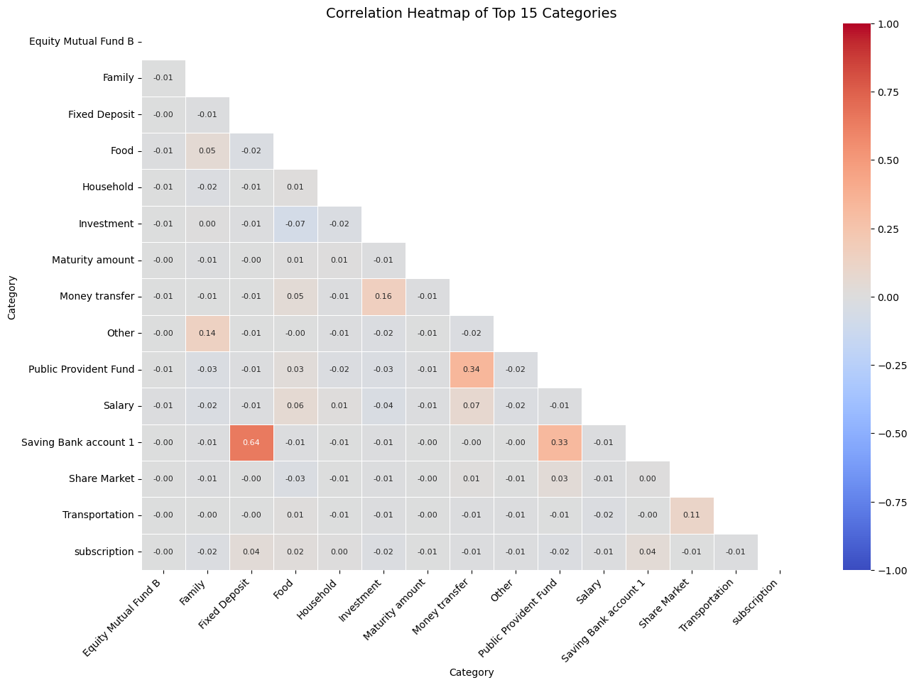
Correlation Heatmap

Slide 21
Correlation Heatmap of Top 15 Categories (Analysis)
Saving Bank account 1 + Fixed Deposit: 0.64 –
Very strong positive correlation, likely means that when transactions occur in “Fixed Deposit”,
they might be done this.
Savings bank account 1 + Public Provident Fund(PPF): 0.33 – It indicates positive relation,
means when savings bank account 1 increases, public provident fund also increases. It might
indicate when salary is deposited in bank, PPF is also deposited by employer.
With Public Provident Fund (PPF): 0.34 – Money Transfer – Indicating that money transfer
may be made for the Public Provident Fund(investment purposes).
Money Transfer + Investment: 0.16
Indicates a modest relationship, money transfer and investment increases together
Investment ↔ Public Provident Fund: Slight negative correlation (-0.03).
Suggests that when money is going into PPF, it might slightly reduce other forms of investment.
Most other correlations are very close to 0, meaning categories like:
Equity Mutual Fund B, Food, Transportation, Subscription → these operate independently
of others.

Slide 22
Summary
Food and Milk
Food related transactions are regular and routine.
Food and Subscription have relatively consistent spending, with fewer large outliers.
Milk has the highest frequency in the sub-category more than 160. It means that people are buying milk frequently and regularly.
This provides an opportunity to the milk producing companies to market and cater to these needs.
Credit Card and Savings Bank
Most expense transactions are carried out by using credit card, debit card, savings bank account 1.
This gives opportunity for the credit card companies to use A.I, and create customized card offers to the customers.
This also banks an opportunity to provide lending to the customers to buy high value products by providing affordable loans with low interest rates.

